Slide 1
SystemScape
Client Interview Results

Slide 2
Torrent Pharmaceuticals
Subteam 1

Slide 3
Business Goal
Distributes products to drug stores
Keep track of these transactions
Mapping the reports into their own records.
Automate this mapping process
Save time and minimize errors

Slide 4
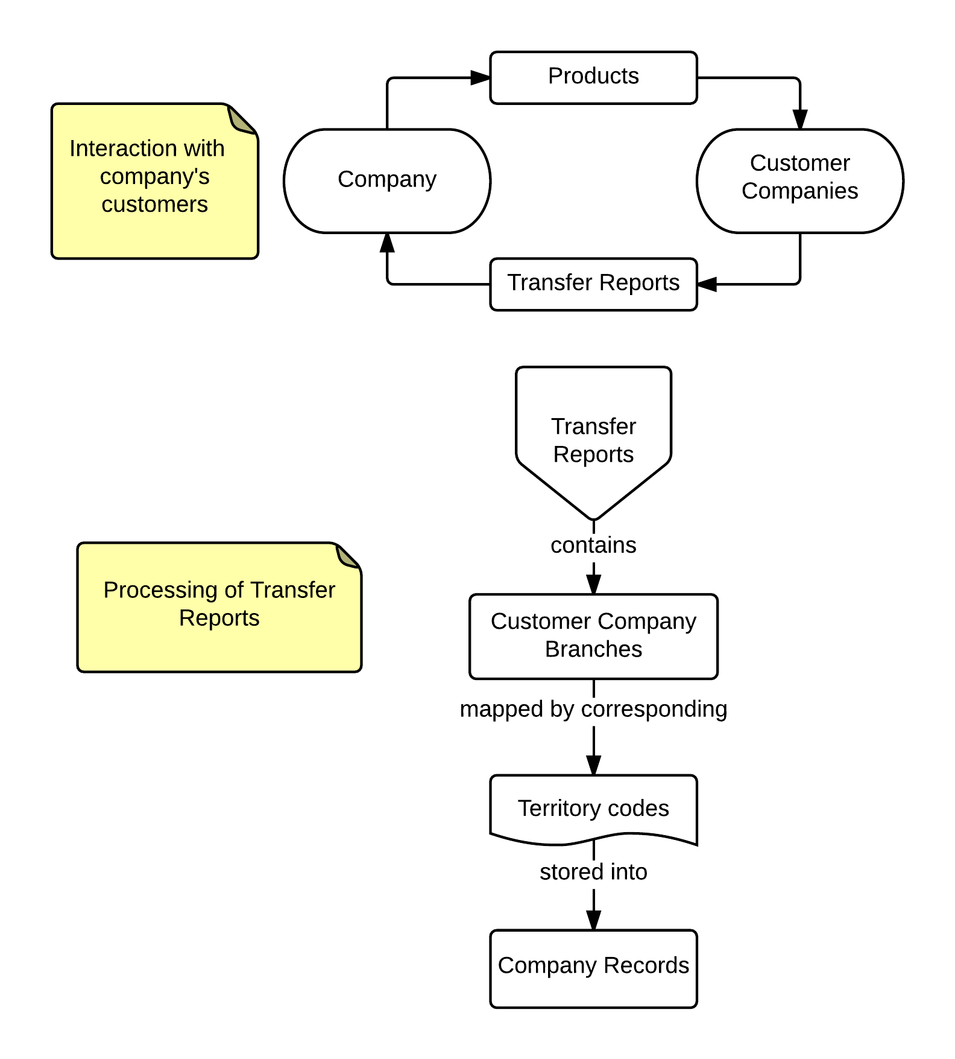
Process

Slide 5
Characteristics
Efficient and effective at mapping the transfer reports
Effectively handle different kinds of users and their respective restrictions
Allow customization as well as revisions for the data

Slide 6
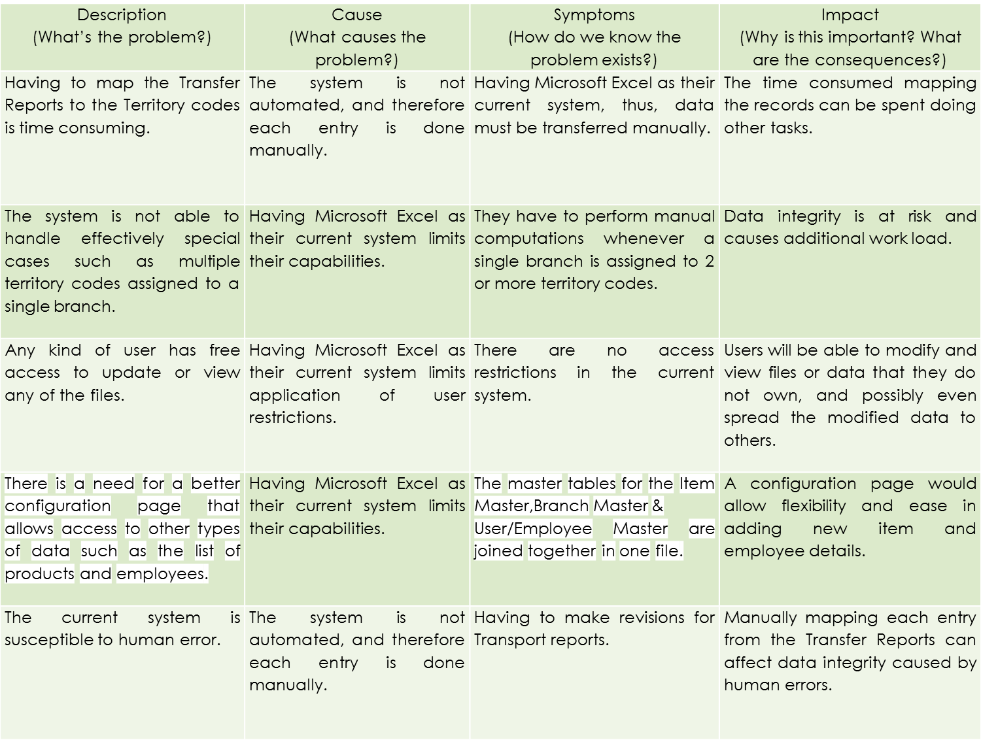

Slide 7
CAI-STA
Subteam 2

Slide 8
Business Goals
Have a consistent inventory system
  Keep track of items
  Person they are assigned to
  Project the item is being used for
Have a system to keep track of the purchase orders and contracts
Warranty expiries and ends of contracts should also trigger notifications.

Slide 9
Characteristics
Present consistency in records
Ease in
  Creating purchase orders
  Adding items to inventory
  Generating the necessary reports.
Have the correct information at all times
Be easily maintainable.

Slide 10
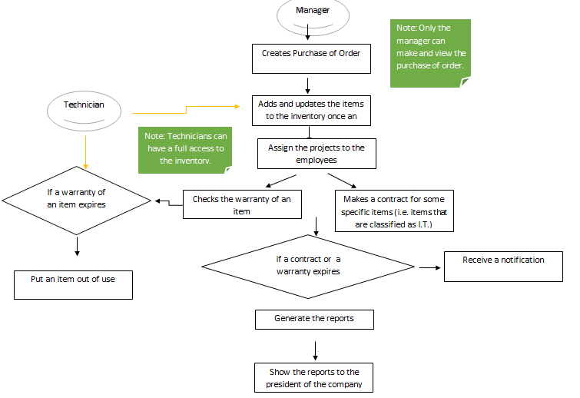

Process

Slide 11
Description (What’s the problem?) | Cause (What causes the problem?) | Symptoms (How do we know the problem exists?) | Impact (Why is this important? What are the consequences?)
The current approach in managing the inventory for purchases and the purchase order is inefficient. | The client uses MS Excel in handling the aforementioned business documents. | The client consumes a lot of time in making the documents such that she lacks time in doing other important tasks. | The inefficient approach of handling these documents may jeopardize the integrity of the data and may lead to other problems that may be caused by human error.
There are instances wherein the client overlooked contracts of some items and end of warranties. | MS Excel does not have a notification feature that the client needs to manually set the dates in a calendar application for her to be notified. | The end of warranties and contracts of some items are often overlooked by the client. | If a piece of equipment was to get damaged, and its warranty or contract weren’t renewed, then there will be complications in the repair or replacement of that piece of equipment.
The current approach in managing the inventory is open to inconsistencies. | There is no centralized database for easy data management; instead multiple MS Excel files are used, often for the same data. | The client uses multiple MS Excel files in updating her inventory so discrepancies and duplications of data often occur. | Discrepancies of information between the records and the actual availability of the equipment can lead to complications in the handling of this equipment.
The client is experiencing a difficulty in filtering items that are of the same type. | There is no automated system available to aid the client in sorting the items. | The client needs to have a separate MS Excel sheets to manually sort the items by their category. | Having multiple files containing the same data just for the sake of rearranging and regrouping them can open the system to discrepancies between these files and invalid information.
It is difficult to keep track of the projects assigned to an employee. | The client needs to access multiple files in order to know which projects are assigned to which employee. | Projects that are already assigned to an employee can be assigned to another employee. | This can cause the company to lose track of which employee is responsible for which project in the company.

Slide 12
Camella Homes
Subteam 3

Slide 13
Business Goals
Allow their clients to immediately be able to see the cost of the proposed building
  Based on the materials and dimensions of the building.
Their current system is tedious
  Requires more time to accomplish the task:
    Compute and estimate the overall cost of the building.

Slide 14
Characteristics
Data should not be easily tampered.
Easy to maintain
Secure and safe(no information leak)
Extensible(easy to add/delete feature)

Slide 15
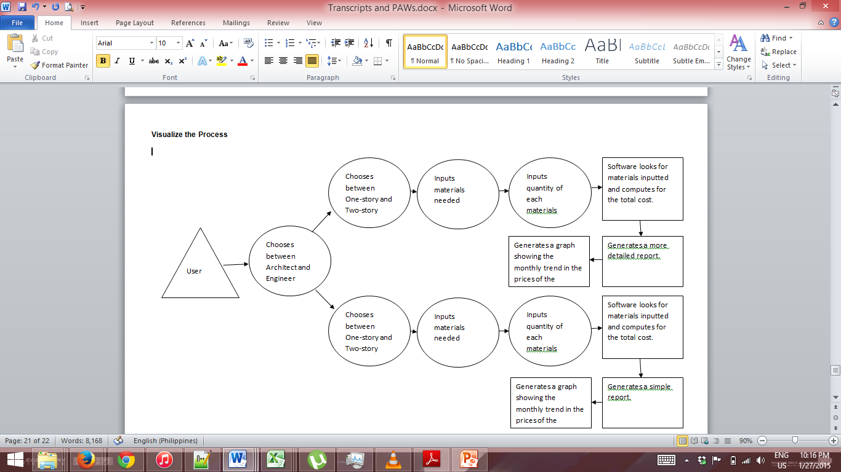
Process

Slide 16
Description (What’s the problem?) | Cause (What causes the problem?) | Symptoms (How do we know the problem exists?) | Impact (Why is this important? What are the consequences?)
The current system, an Excel Spreadsheet document, is prone to errors and inconsistencies | The current system does not provide checking and validation in terms of the data entered by the users | The current system is not optimized for this type of work. | It is important because in this case, data integrity will be affected, and because the system computes for the overall cost of the building based on the input data; the entire system depends on each input
There are many unnecessary work involved in the current system which makes it tedious such as having to scan the whole document just to compare and look for the desired material. | The user must still have to look for the desired material in the spreadsheet one by one just to complete the process and get the desired computation. | This kind of feature does not exist in Microsoft Excel | The process would be very time-consuming due to it being complex. Because of this, the process requires close monitoring of the data in every spreadsheet. This would also result to the further increase of inconsistencies due to the complexity of the current system.
The process can only be performed by someone who is capable of using the spreadsheet and knowledgeable of how the data should be used in computing for the total cost of the building | Not all the users know how to use excel and are knowledgeable on the contents of the system. | There are people who are not aware of how the system works | The process would require a user who knows how to input data and arrive at the overall computation based on the given inputs.
The process of keeping track of the list of materials needed for construction and its current cost in the market manually requires lots of time and effort and requires the user to look into many resources | The cost of materials may vary from time to time depending on its supply and demand in the market. The list of materials increases as new types of materials are introduced into the industry. | The market and economy is constantly changing due to supply and demand among countries | Being aware of the cost of the materials is integral to construction since a small change in the cost of a single material would affect the cost of the finished building exponentially
It is hard to make computations in calculating the cost of the building, and would take much time to compute and double check the result. | It makes use of complex formulas which could take plenty of time to compute manually. | There are construction projects that could not start on time because the client and the construction firm would not agree on the price. This is most likely due to miscalculations | The calculation of the building cost is the most integral process of the construction industry’s business side. The project could not start unless the correct cost is presented to the client. A lengthy calculation would mean the completion of the building would be delayed

